Slide 1
A Study on Summer Olympic Medal Tallies
Exploring the relation between race/ethnicity and chances of winning a medal
PBL Submission for Data Visualization (CSE3020)

Slide 2
Medal count by Type per Region
Africa
Bronze
Australia
Silver
Central America
Gold
Central Europe
East Asia
Eastern Europe
Indian Subcontinent
Middle East
Minorities and Others
North America
Northern Europe
South America
South East Asia
Western Europe
0
K
1
K
2
K
3
K
4
K
5
K
6
K
7
K

Slide 3
Medal Haul By Region Over the Years
Edition
Australia
500
Central America
Central Europe
East Asia
400
Eastern Europe
Indian Subcontinent
s
Middle East
l
Minorities and Others
a
d
North America
e
300
M
f
Northern Europe
o
r
South America
e
b
m
South East Asia
u
N
200
Western Europe
100
0

Slide 4
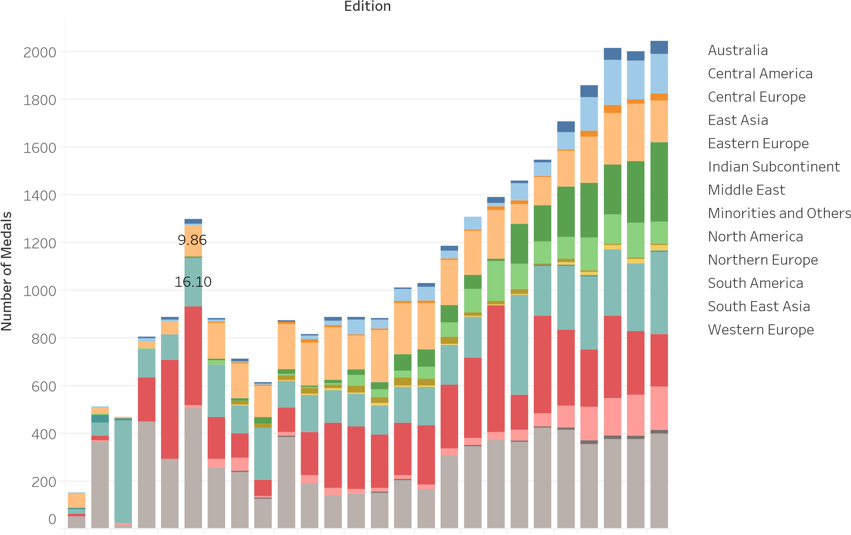
Medal Breakdown By Region Per Edition

Slide 5
Percentage of Medals Won By Regions
Africa
Australia
Central America
80
Central Europe
n
East Asia
o
Eastern Europe
W
s
l
60
Indian Subcontinent
a
d
e
Middle East
M
f
o
Minorities and Others
e
40
g
North America
a
t
n
Northern Europe
e
c
r
e
South America
P
20
South East Asia
Western Europe
0

Slide 6
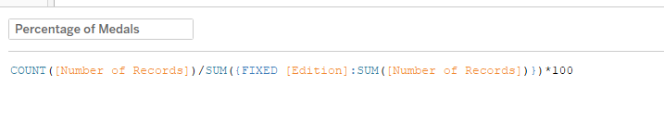
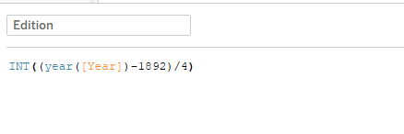
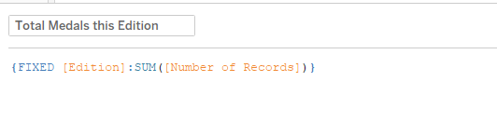
Calculated Fields Used

Slide 7
Percentage of Medals Won By Region (with Prediction in Python)
90
Region
Africa
Australia
80
Central America
Central Europe
70
East Asia
n
Eastern Europe
o
60
Indian Subcontinent
W
s
l
Middle East
a
d
e
50
Minorities and Others
M
f
North America
o
e
Northern Europe
g
a
40
t
n
South America
e
c
r
South East Asia
e
P
30
Western Europe
20
10
0

Slide 8
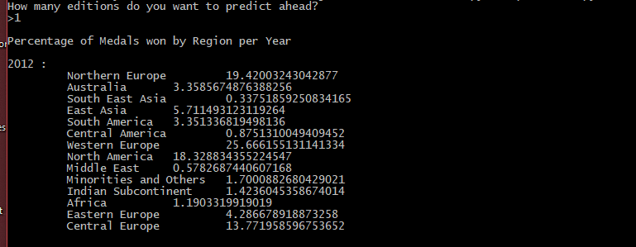
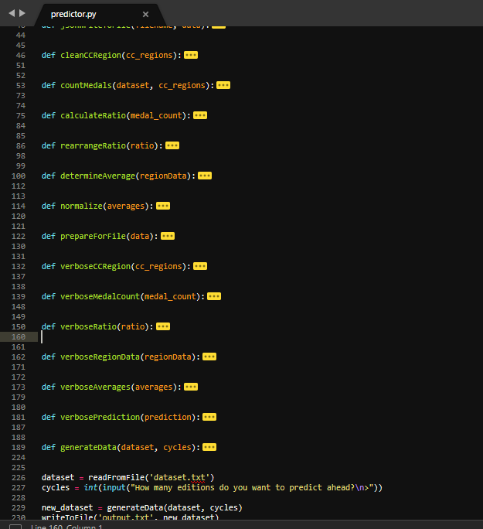
Percentage of Medals Won By Region (with Prediction in Python)

Slide 9
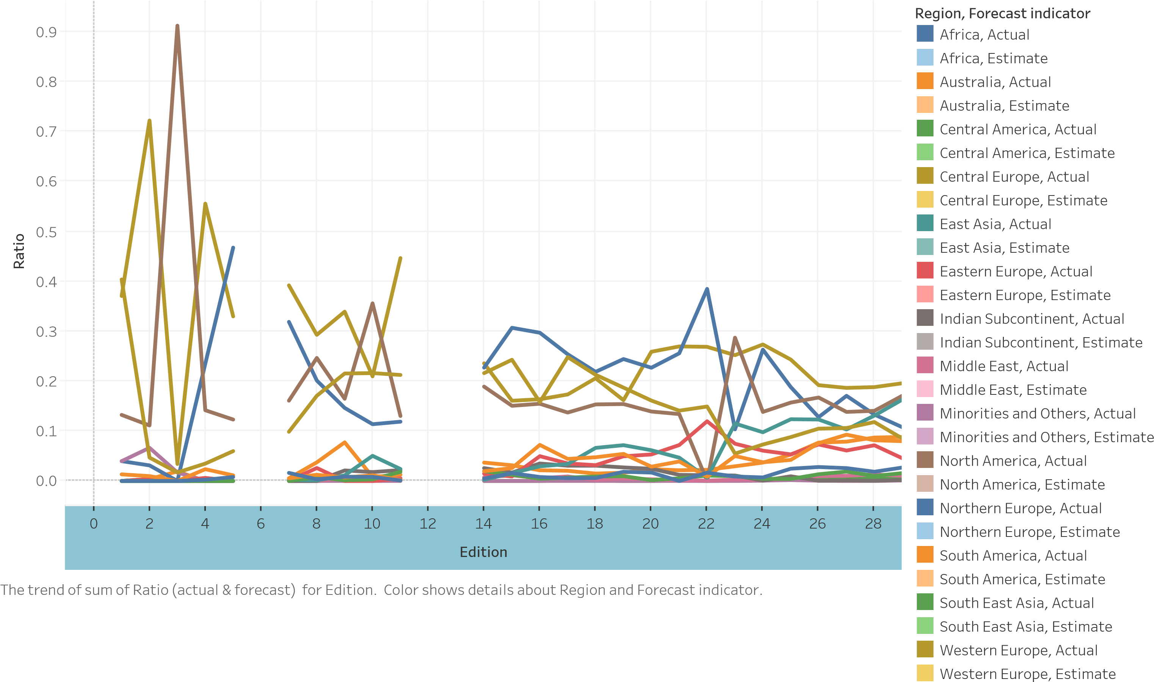
Percentage of Medals Won By Regions

Slide 10
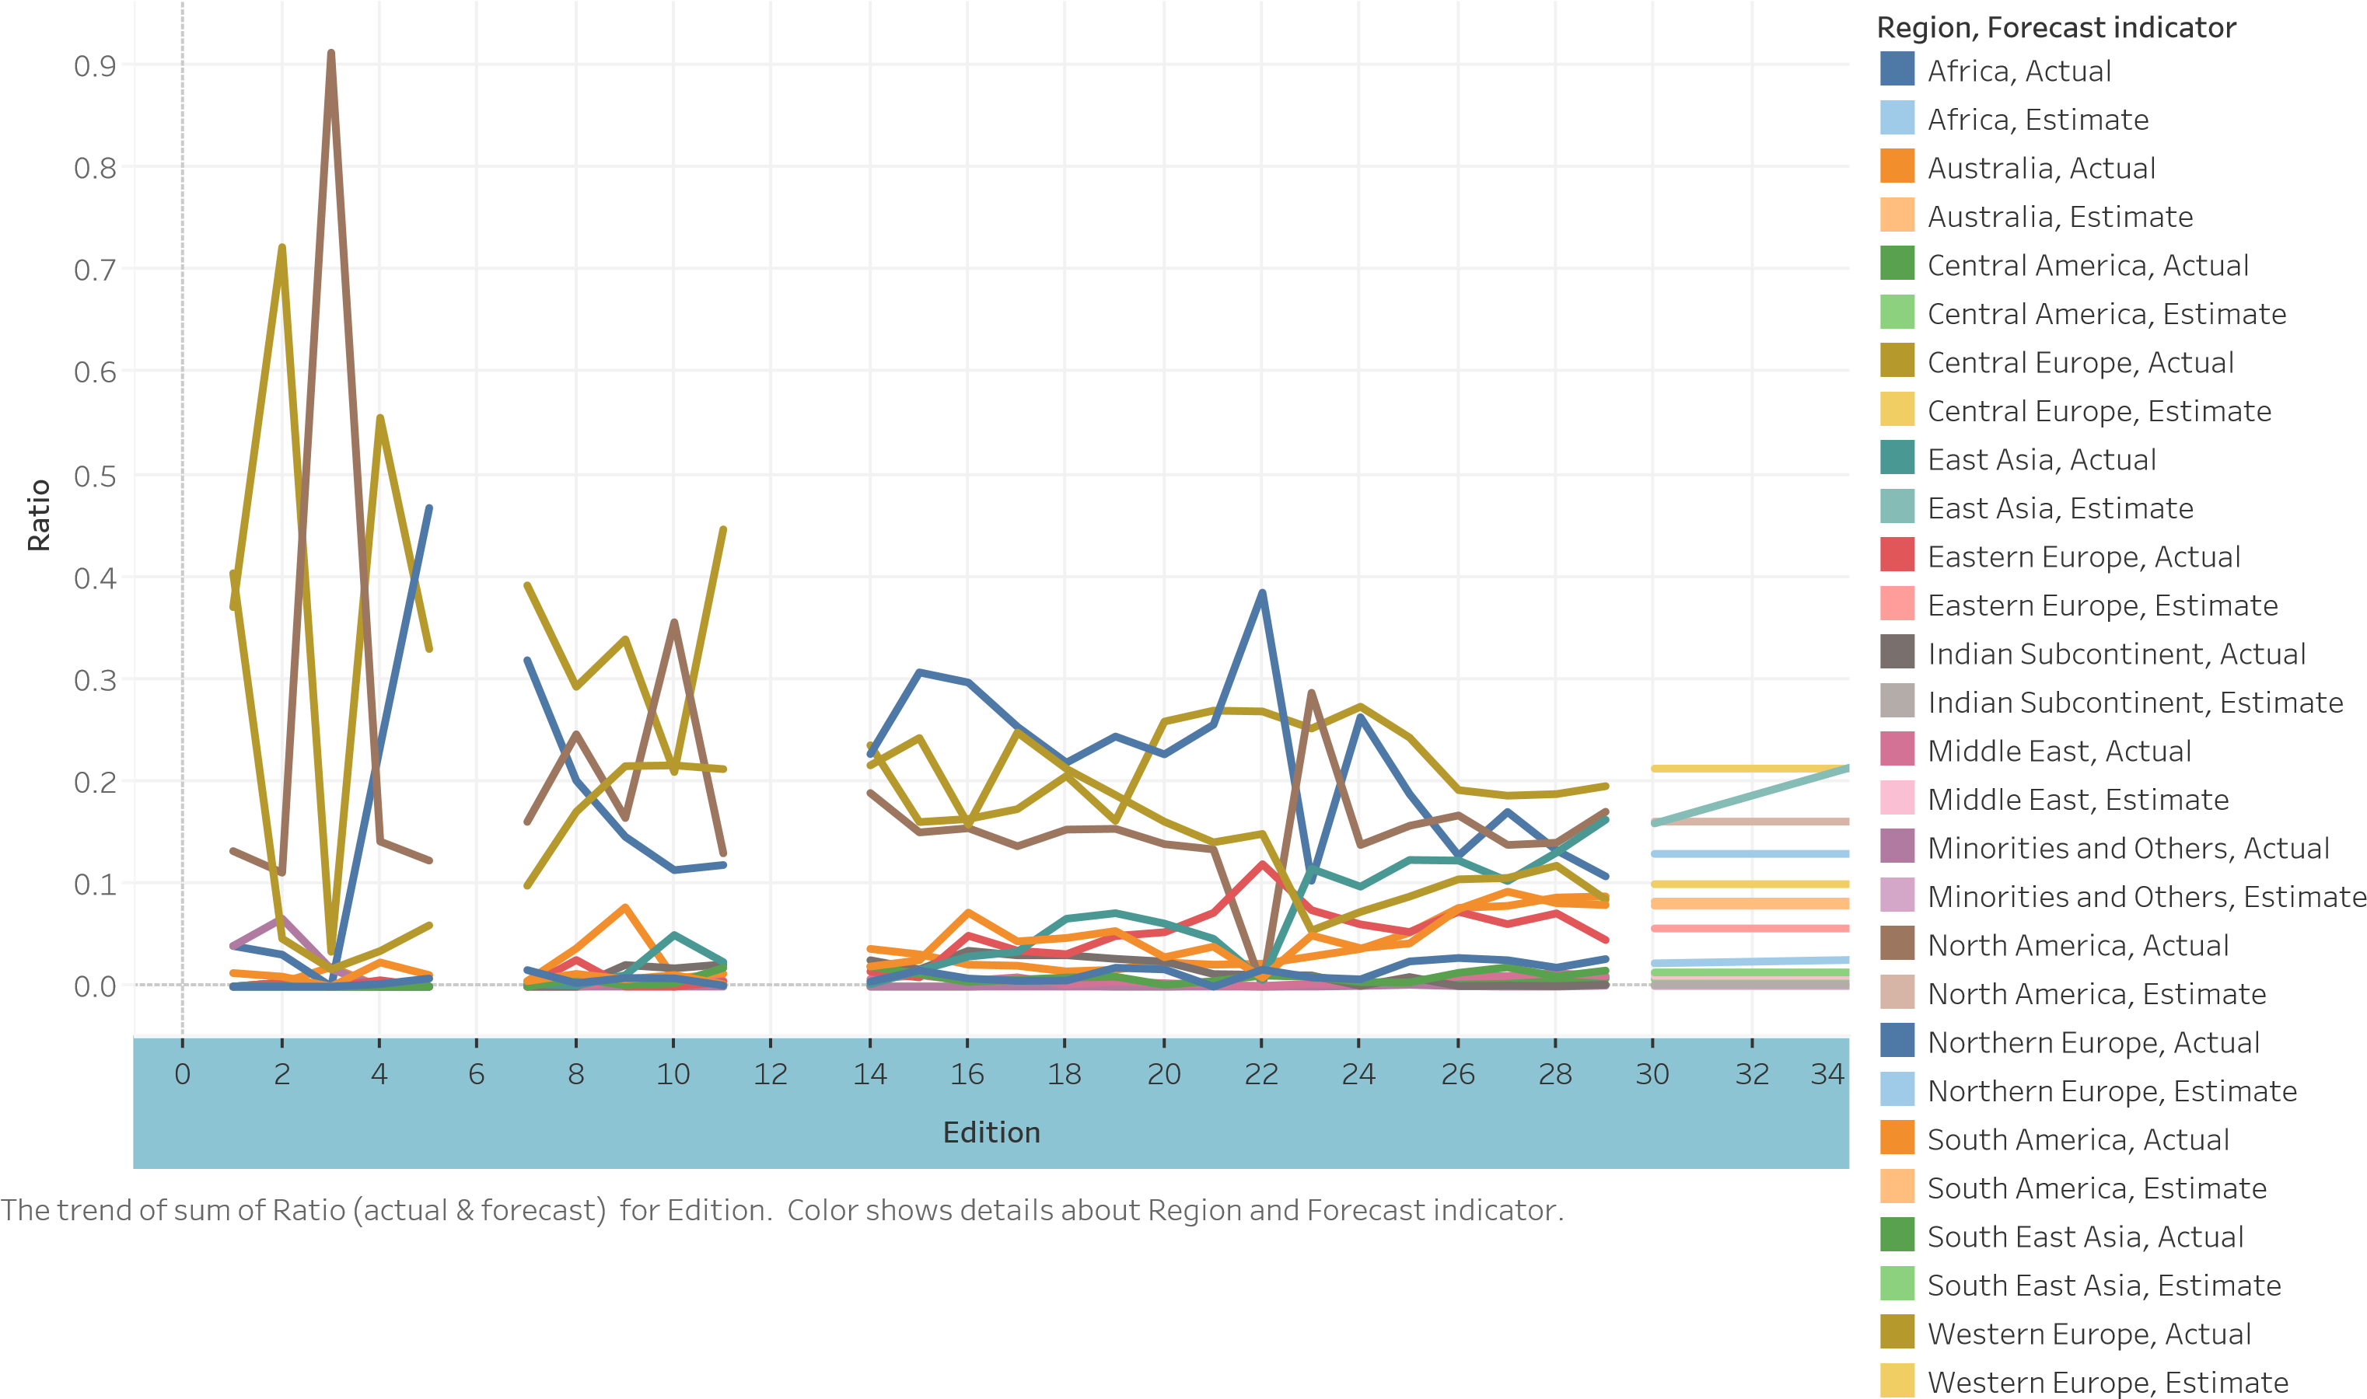
Percentage of Medals Won By Region (with Prediction in Tableau)

Slide 11
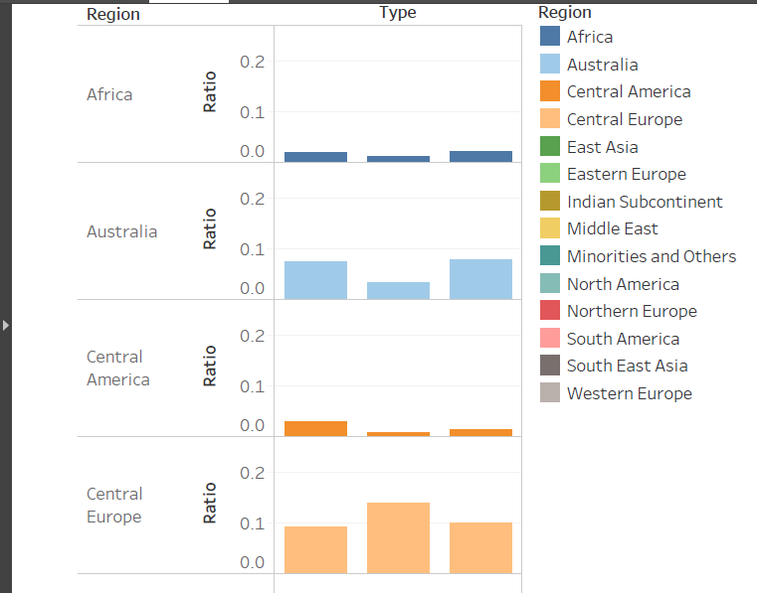
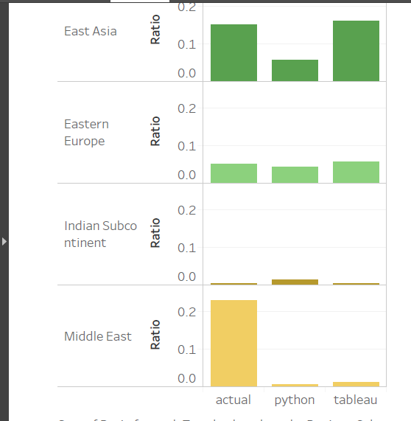
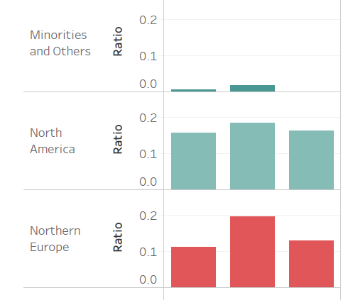
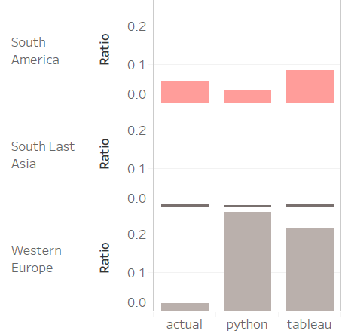
A Comparison of Generated and Actual Data

Slide 12
Done By
MUDIT BHARTIA (16BCE1100)
KAUSHIK CHATTERJEE (16BCE1067)
HARSHIT MAHESHWARI (16BCE1046)

